Slide 1
Storing Data
Android Developer Fundamentals
Lesson 9
This work is licensed under a Creative Commons Attribution-NonCommercial 4.0 International License

Slide 2
Contents
SharedPreferences
Files
Internal Storage
External Storage
SQLite Database
Other Storage Options

Slide 3
Storage Options

Slide 4
Storing data
Shared Preferences—Private primitive data in key-value pairs
Internal Storage—Private data on device memory
External Storage—Public data on device or external storage
SQLite Databases—Structured data in a private database
Content Providers—Store privately and make available publicly

Slide 5
Storing data beyond Android
Network Connection—On the web with your own server
Cloud Backup—Back up app and user data in the cloud
Firebase Realtime Database—Store and sync data with NoSQL cloud database across clients in realtime

Slide 6
9.1 Shared Preferences
This work is licensed under a Creative Commons Attribution-NonCommercial 4.0 International License

Slide 7
Contents
Shared Preferences
Listening to changes

Slide 8
What is Shared Preferences?
Read and write small amounts of primitive data as key/value pairs to a file on the device storage
SharedPreference class provides APIs for reading, writing, and managing this data
Save data in onPause() restore in onCreate()

Slide 9
Shared Preferences and Saved Instance State
Shared Preferences AND Saved Instance State
Small number of key/value pairs
Data is private to the application

Slide 10
Shared Preferences vs. Saved Instance State
Shared Preferences vs. Saved Instance State
Persist data across user sessions, even if app is killed and restarted, or device is rebooted
Data that should be remembered across sessions, such as a user's preferred settings or their game score
Common use is to store user preferences
Preserves state data across activity instances in same user session
Data that should not be remembered across sessions, such as the currently selected tab or current state of activity.
Common use is to recreate state after the device has been rotated

Slide 11
Creating Shared Preferences
Need only one Shared Preferences file per app
Name it with package name of your app—unique and easy to associate with app
MODE argument for getSharedPreferences() is for backwards compatibility—use only MODE_PRIVATE to be secure

Slide 12
getSharedPreferences()
private String sharedPrefFile = "com.example.android.hellosharedprefs";
mPreferences = getSharedPreferences(sharedPrefFile, MODE_PRIVATE);

Slide 13
Saving Shared Preferences
SharedPreferences.Editor interface
Takes care of all file operations
put methods overwrite if key exists
apply() saves asynchronously and safely

Slide 14
SharedPreferences.Editor
@Override
protected void onPause() {
super.onPause();
SharedPreferences.Editor preferencesEditor =
mPreferences.edit();
preferencesEditor.putInt("count", mCount);
preferencesEditor.putInt("color", mCurrentColor);
preferencesEditor.apply();
}

Slide 15
Restoring Shared Preferences
Restore in onCreate() in Activity
Get methods take two arguments—the key, and the default value if the key cannot be found
Use default argument so you do not have to test whether the preference exists in the file

Slide 16
Getting data in onCreate()
mPreferences = getSharedPreferences(sharedPrefFile, MODE_PRIVATE);
if (savedInstanceState != null) {
mCount = mPreferences.getInt("count", 1);
mShowCount.setText(String.format("%s", mCount));
mCurrentColor = mPreferences.getInt("color", mCurrentColor);
mShowCount.setBackgroundColor(mCurrentColor);
mNewText = mPreferences.getString("text", "");
} else { … }

Slide 17
Clearing
Call clear() on the SharedPreferences.Editor and apply changes
You can combine calls to put and clear. However, when you apply(), clear() is always done first, regardless of order!

Slide 18
clear()
SharedPreferences.Editor preferencesEditor = mPreferences.edit();
preferencesEditor.clear();
preferencesEditor.apply();

Slide 19
Listening to Changes

Slide 20
Listening to changes
Implement interface SharedPreference.OnSharedPreferenceChangeListener
Register listener with registerOnSharedPreferenceChangeListener()
Register and unregister listener in onResume() and onPause()
Implement on onSharedPreferenceChanged() callback

Slide 21
Interface and callback
public class SettingsActivity extends AppCompatActivity
implements OnSharedPreferenceChangeListener { ...
public void onSharedPreferenceChanged(
SharedPreferences sharedPreferences, String key) {
if (key.equals(MY_KEY)) {
// Do something
}
}
}

Slide 22
Creating and registering listener
SharedPreferences.OnSharedPreferenceChangeListener listener =
new SharedPreferences.OnSharedPreferenceChangeListener() {
public void onSharedPreferenceChanged(
SharedPreferences prefs, String key) {
// Implement listener here
}
};
prefs.registerOnSharedPreferenceChangeListener(listener);

Slide 23
You need a STRONG reference to the listener
When registering the listener the preference manager does not store a strong reference to the listener
You must store a strong reference to the listener, or it will be susceptible to garbage collection
Keep a reference to the listener in the instance data of an object that will exist as long as you need the listener

Slide 24
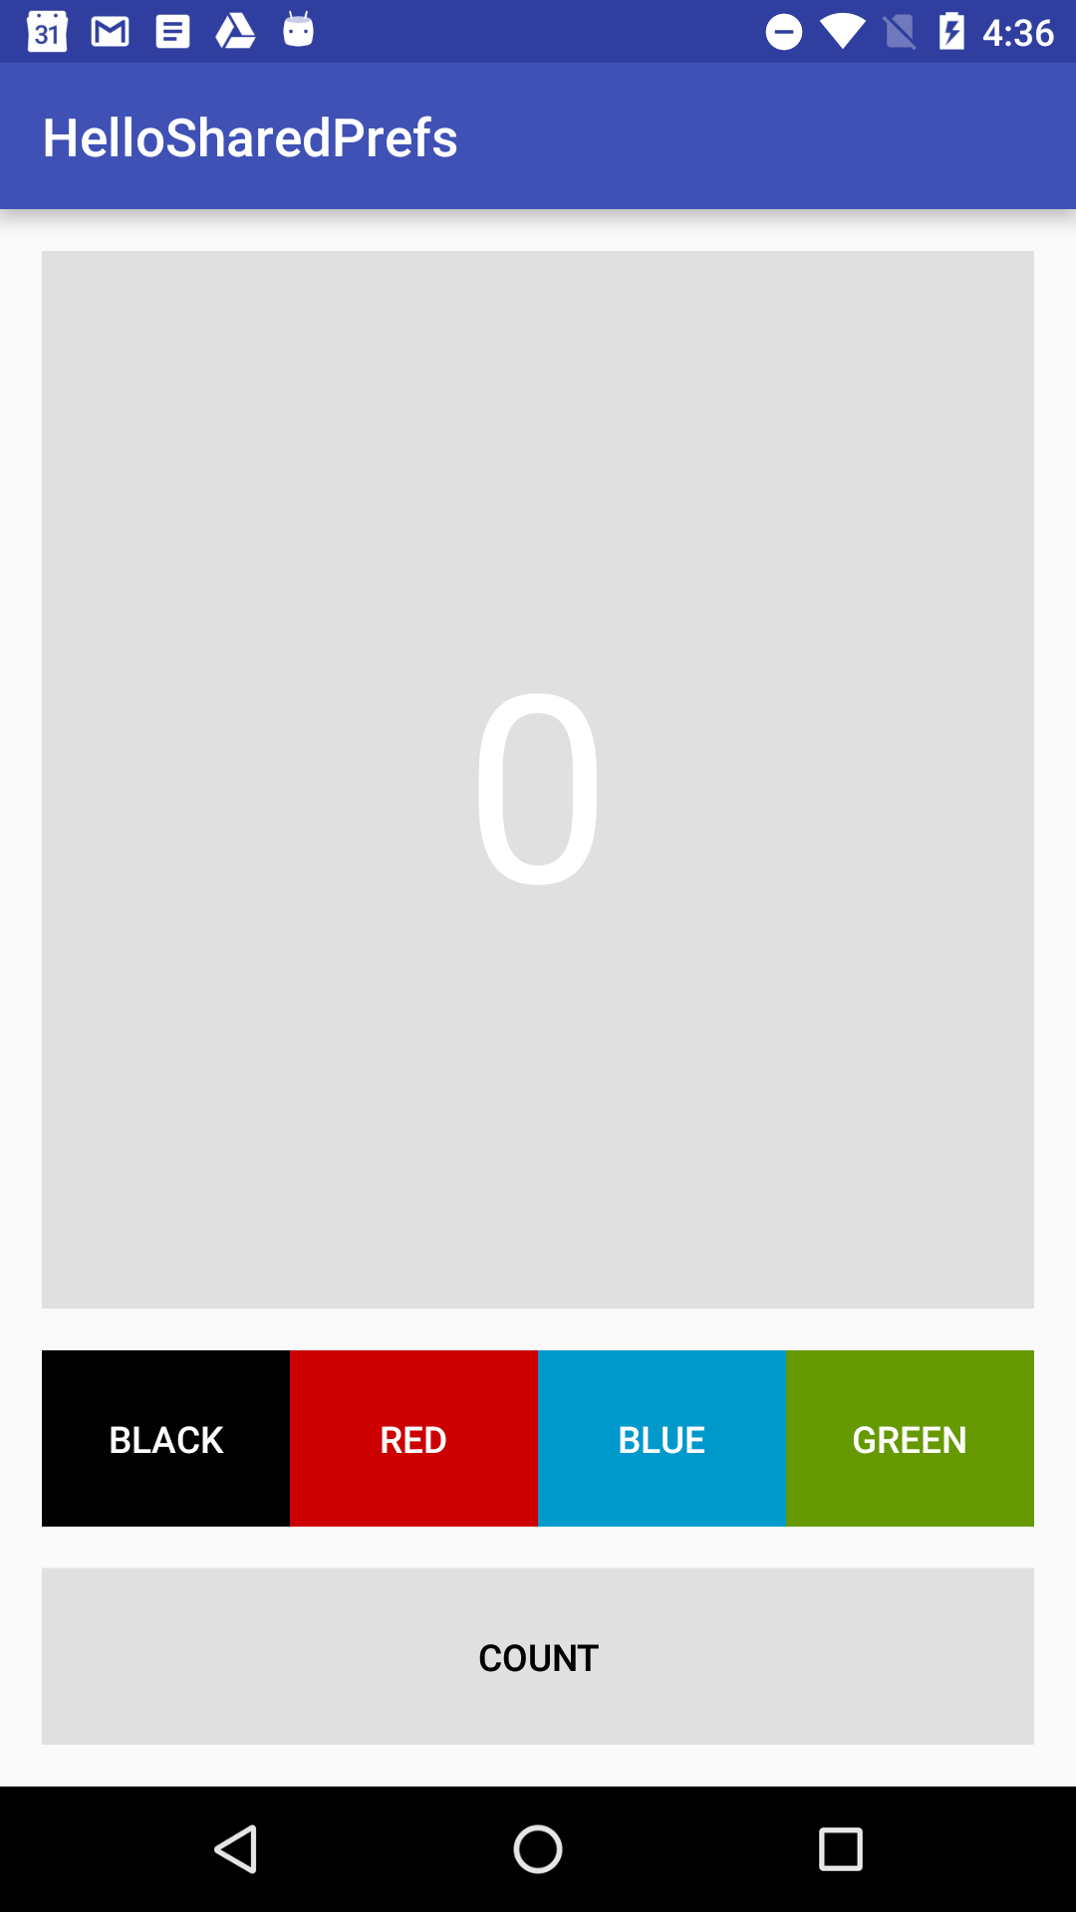
Practical: HelloSharedPrefs
Add Shared Preferences to a starter app
Add a "Reset" button that clears both the app state and the preferences for the app

Slide 25
Learn more
Saving Data
Storage Options
Saving Key-Value Sets
SharedPreferences
SharedPreferences.Editor
Stackoverflow
How to use SharedPreferences in Android to store, fetch and edit values
onSavedInstanceState vs. SharedPreferences

Slide 26
What's Next?
Concept Chapter: 9.1 C Shared Preferences
Practical: 9.1 P Shared Preferences

Slide 27
END

